Slide 1
17-11-2014
The circular economy &
Dutch household waste
Roel van Raak
DRIFT / Erasmus Universiteit Rotterdam
vanraak@drift.eur.nl

Slide 2
DRIFT: Dutch Research Institute for Transitions
Institute of Erasmus University
Transition = fundamental change in structure, culture and practice of functional system(s) in society.
  Industries, policy fields, regions.
Research, education, consultancy, practice
Making connections:
  bridging historical, short term and future studies
  bridging description and prescription
  bridging disciplines
  bridging science and practice
  bridging industries and regions
  bridging the social, economical and environmental

Slide 3
circular economy research @drift
research into the role of municipalities and the next step in waste transition
research into regions / areas / clusters
research into role of companies and sectors in the circular economy
research in social aspects, local sustainable economies, etc.

Slide 4
Presentation
Introduction municipal waste
1. Vision and large trends
3. Tactical / Strategic behaviour
2. Operational options / performance
Role of the analyst
Please interrupt

Slide 5
Municipal / household waste
municipal and household largely overlap
complex stream (many different materials in small quantities)
in mass only a fraction of all waste, but very visible in everyday life
collect – process – use/dispose
citizen behaviour key
EU Hierarchy ( in principle binding) / EoW
  Prevent -> Reuse -> Recycle -> Recovery (energy) -> Disposal (landfill)
Multi-billion industry
very different approaches in different countries >>

Slide 6
Dutch history of waste
Pre-industrial local economic systems
Dominance of residual waste, landfill & undegradable materials
1960’s: growing environmental consciousness
1980’s – 2000’s, medium to large scale recyling
  paper
  glass
  green waste
1990’s – present, waning environmental conciousness, or new priorities (energy & climate change).

Slide 7
TRENDS AND VISIONS

Slide 8
producer responsibility
EU waste framework directive + specific directives
producer remains responsible after sale (second half of product cycle)
polluter pays & ecodesign
In principle private affair (for example take back), in practice public and/or collective component
  each EU country makes own choices
cars, e-waste, batteries, packaging

Slide 9
producer responsibility
Effects on Dutch waste system
New system for electronics recycling and car recycling
Packaging: integration into public system for collection and treatment (plastic: private joint treatment till 2015)
  tax / levy / fee
    based on environmental load per material type (unrecyclable=expensive)
    based on turnover
    based on recycling efforts (unrecyclable=free)
  Plastic packaging as primary concern
    From quality (limited deposit) to quantity

Slide 10
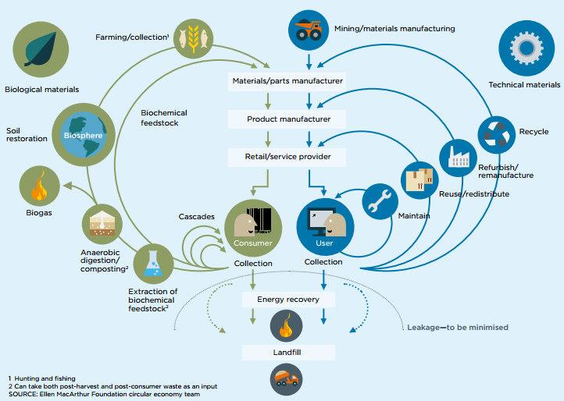
circular economy
Main protagonists: MacArthur / McKinsey
cycling longer (durable and cascades)
cycling purer
cycling tighter (e.g. refurb)

Slide 11
circular economy

Slide 12
circular economy: fad?
Builds explicitly upon earlier trends:
  3R’s, waste hierarchies
  industrial ecology
  ecodesign
  producer responsibility
  cradle-to-cradle
Sometimes ignores existing economic viable, private recycling systems
Buzzword for limited product range

Slide 13
circular economy: trend?
Quality and added value (just recycling is not good enough)
  Addressing material ⬄ energy contradiction
from public responsibility to business case for the boardroom.
  ….from ecopremium to resource hedging
  linked to Porter’s competition models
  linked to economic models (product-service combinations, performance based economy)
unanswered questions in upscaling (hopeful montrosity?)
  can companies invest upfront for leasing? Effects on their balance?
  coordination of chains
  legal implications of shift in ownership
  ideological and ethical questions of private intrusion
  reverse logistics nightmare

Slide 14
circular economy and municipal waste
higher quality demands on streams
  quantative challenge remains
tension in scales between local/regional/national waste streams and (inter)national production systems
  municipality as waste director policy / law
waste becomes a resource
  ‘loosing’ profitable streams, e.g. textile

Slide 15
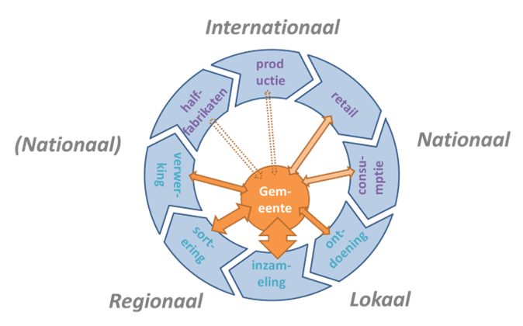

Slide 16
OPERATIONAL - PRACTICE

Slide 17
Dutch best practices in waste recycling
Red thread: removing or reversing perverse incentive on residual waste
local tax proportional to residual waste (DIFTAR)
  ‘Rewards for waste’ (personal, charity, community)
highly frequent collection of recyclables
  less frequent residual waste
  Reversing curbside / collection points
single dry recyclables stream
post-consumer separation of plastics
re-use option in large object collection
citizen involvement and communication

Slide 18
Dutch best practices in waste recycling: results
best municipalities are down to 20 kg per capita residual waste (from typ. 200 kg)
  Hawthorne effect & local pride
plans for local / regional cycles
  Street lights, coffee-machines, local social agenda
post-consumer separation recovers mayority of plastics (quality trade-off)
Full cycle enterprises (paper, paper cups)

Slide 19
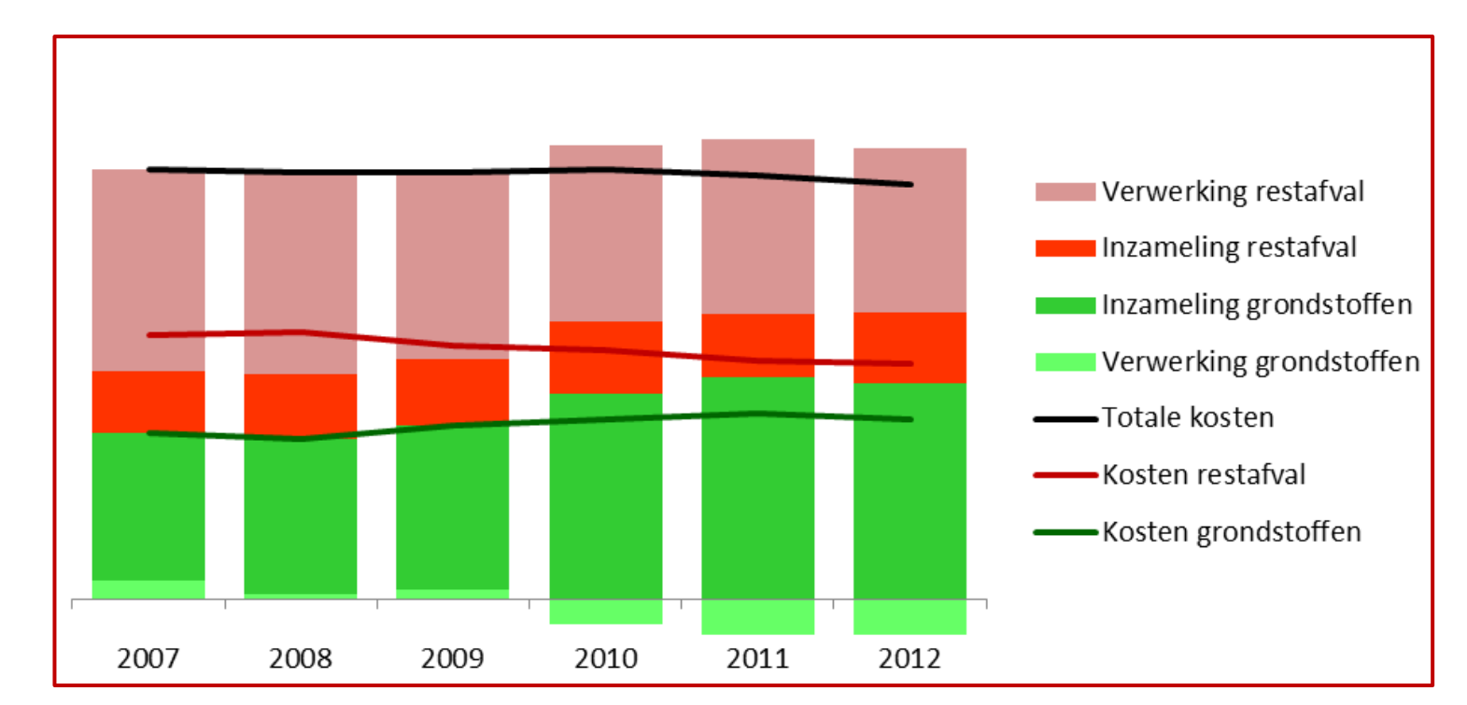
First signs of circular economy
(Circulus / Berkel)
total costs
processing residual waste
collecting residual
collecting recyclables
selling recyclables

Slide 20
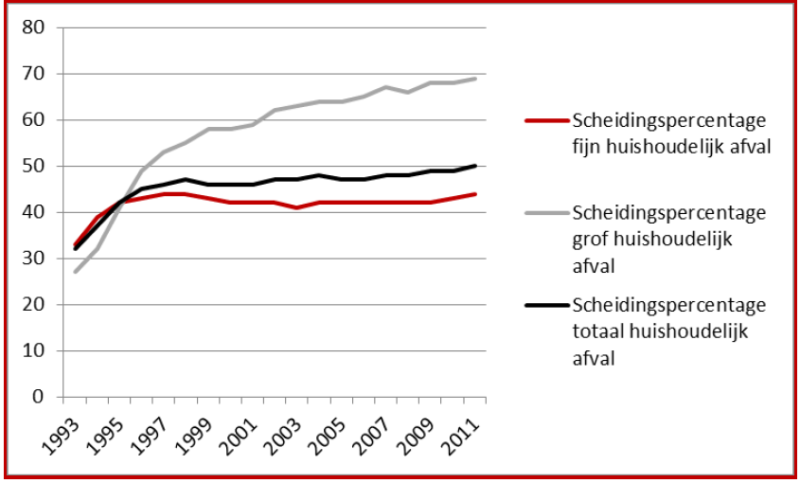
Stagnation despite innovation
Small objects
(regular collection)
Large objects (e.g. furniture, fridges)
Total

Slide 21
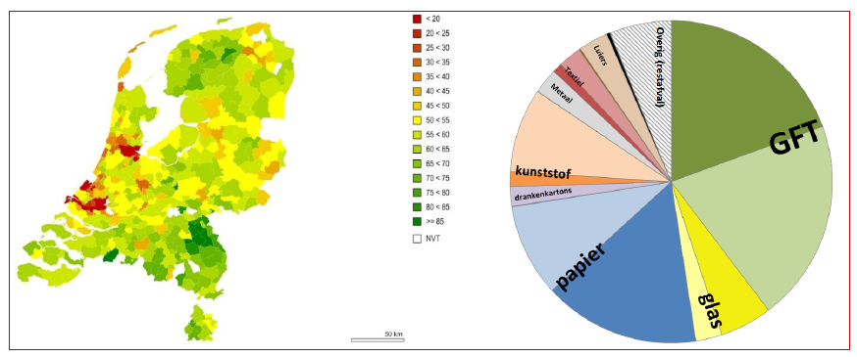
Huge differences per stream and between municipalities
diapers
green
Waste
textile
plastic
tetrap.
source separation for recycling (green)

Slide 22
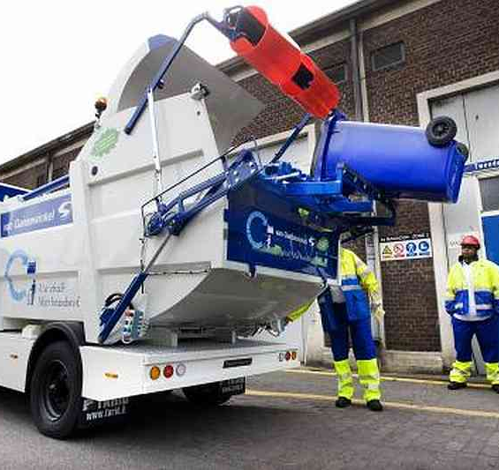
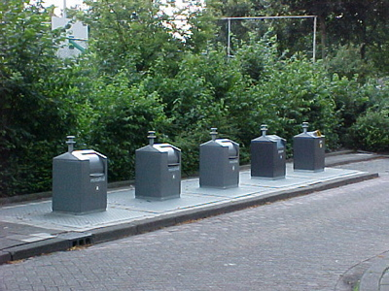
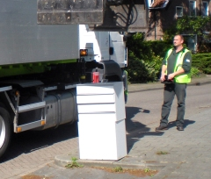
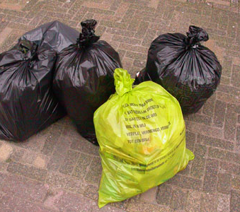
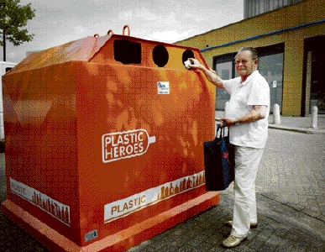
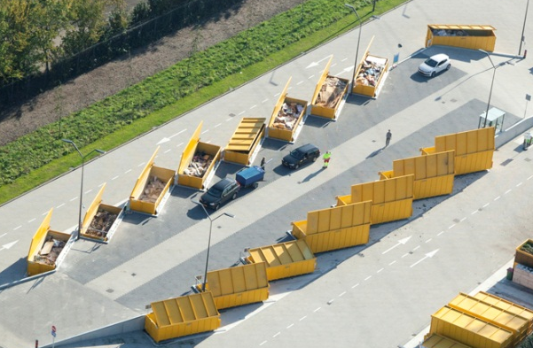
Waste collection systems
CURBSIDE
COLLECTION POINTS
LARGE OBJECTS
COLLECTION
POINTS
COLLECTION
POINTS

Slide 23
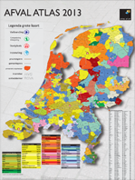
Organisation
Public system, run by municipalities’ own services or hybrids:
  contracting private firms / tendering for public task
  private firms with public shareholder
  joint agencies of multiple municipalities
  contracting by other municipality
  different arrangements for collection, treatment & procurement
Differs also per material and per phase
Private niches:
  Economical viable, e.g. iron, copper
  Bottle deposit systems (large soda, beer)

Slide 24
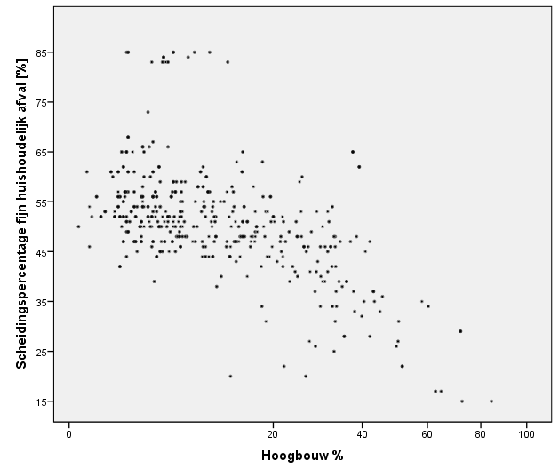
Laggers….
best practices
good practices
System
innovation
Source seperation for recyling (%)
laggers
Appartments
challenges
appartments %

Slide 25
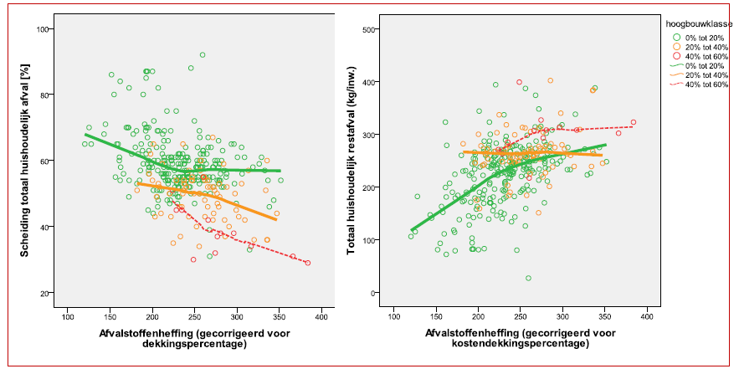
reasons not to adopt…
We are all unique municipalities!
  villages versus city
  demographics
Our streets will be littered!
Our citizens will never accept this!
It is the budget versus the environment!
% source separation of waste
residual waste per capita
costs per capita
costs per capita

Slide 26
..less rational
Not Invented Here syndrome
Or: caught in the headlights
  “don’t fix it if it ain’t broke”
little status in environmental community
senior staff – alderman personality match
institutional disruptive forces

Slide 27
TACITCAL: INTERESTS AND STRATEGIC BEHAVIOUR

Slide 28
more strategic issues
quality first or quantity first?
state-municipality-producers triangle
overcapacity in incineration
public entrepreneurship ⬄ risks, lock-in
accountability of municipalities (65% target)
  who, what, which consequences
further upscaling and corporation
  Local political primate

Slide 29
?

Slide 30
The role of sustainability (policy) analysis and analists
short term versus long term rationality
democracy versus technocracy
pressures can be tough to resist
  not all your positions are rock solid
  aura of authority / personal sympathy
  temptation of information
  time is not on your side
  selective pressures / double standards
  (financial dependencies)
everybody compromises, know what (not) to compromise on
  different positions have different degrees of freedom

