Slide 1
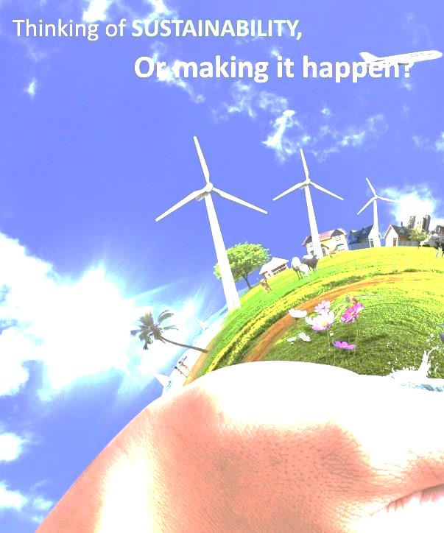
KICK OFF - Engineering for sustainable development
Sorry, temporarily no seats available.
How about greeting your new class mates in the mean time ☺

Slide 2
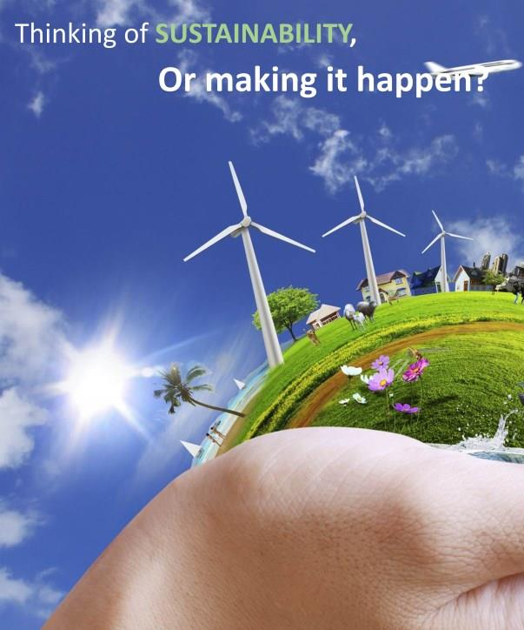
Bertien Broekhans (course manager)
Eefje Cuppen
Caroline Nevejan
Lucas Florez Atehortua
Irma van Bergen Bravenboer
KICK OFF - Engineering for sustainable development WM0939TU

Slide 3
ESD – kick off
13:45-14:30 Introduction
  Welcome and get to know each other
  Learning by doing research
14:45 – 15:15 Texel as a system
  Introduction to socio-technical systems by Eefje
15:15-15:45 Being here
  Introduction in Being-here by Caroline and Dorien: create your profile and first article
16:00-17:30 Texel sustainable
  Doing research
  About Texel as a (un)sustainable island by Han Brezet
Notes:
NB: invoices were send. Please make sure that your contribution is paid before 8 December 2014!
18/32

Slide 4
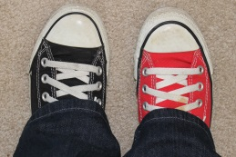
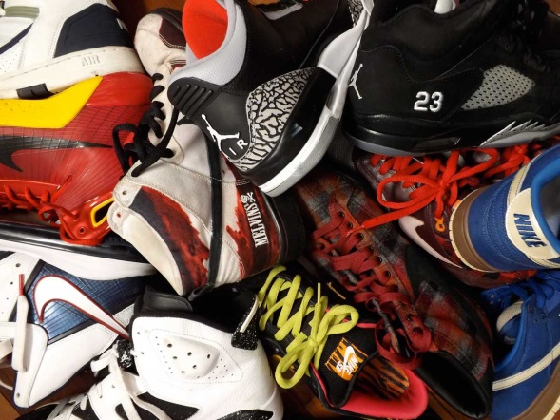

Pair of shoes
When in a big circle we do a round and answer two questions:
a. What is the most unsustainable thing you? Say few words!
b. Who is your sustainability hero & why? State an oneliner!

Slide 5
Engineering for sustainable development
Learning objectives
Experience complexity, tensions and dilemmas that come with sustainable practices and required interdisciplinary efforts.
Consider their role as an engineer with regard to sustainable development and reflect on personal educational objectives, professional values, ethics and beliefs.
Analyse (im)possibilities and design pathways of transitions to sustainable futures of sociotechnical systems.

Slide 6
Thinking of sustainability
6 meetings, 6 topics
Texel sustainable island Wednesday 12 November 13:30-17:30 hrs
From vision to practice Monday 17 November 8:30-12:30 hrs
Transitions made by people Tuesday 25 November 13:30-17:30 hrs
SD in Context Thursday 4 December 8:30-12:30 hrs
Transition Monday 8 December 8:30-12:30 hrs
Leadership Friday 19 December 13:30-17:30 hrs

Slide 7
A research project
provides students with a unique opportunity to explore the connection between organizations, the environment, and society.
allows students to apply knowledge from the classroom to solve real-world problems and see firsthand how organizations are tackling the massive challenges of sustainability.
engages interdisciplinary teams of students in a project with high socio technical complexity and accompanying sustainability challenges.

Slide 8
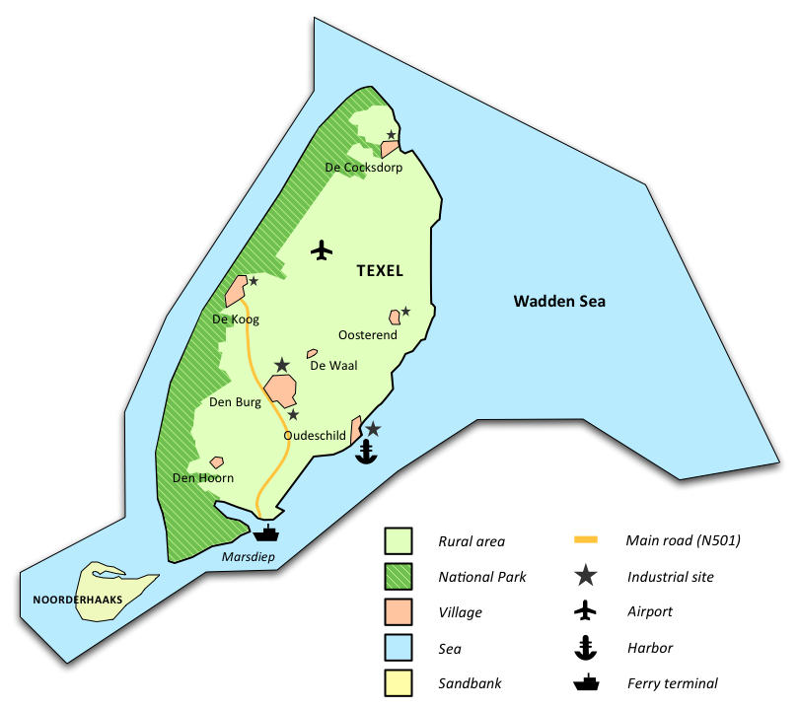
Or making it happen!
Learning by doing research:
Texel as a sustainable island
Characteristics
  Consists largely of water
  Agricultural land, natural areas
  People and sheep
  Great ambitions, many initiatives …
  but transition?

Slide 9
System: Texel
Subsystem Texel as host
Subsystem Water cycle
Subsystem Food & more
Subsystem Mobility
Subsystem From the sea
Subsystem Health & Happiness
Subsystem Public space
Subsystem Materials & waste
Subsystem Leisure & Knowledge

Slide 10
9 sub-systems and 9 groups of students
which group investigates
which sub- system?
host | happiness | Water cycle | Food&more | mobility
Yannick Warmerdam | Pieter van Hall | Robert jan Vos | Iris v/d Brink | Derek v/d Berg
Nick Vlaun | Tiwanee van der Horst | Elia Galiouna | Boris Boschman | Niki Nikolaou
Irina Martjanova |  | Rosanne van Miltenburg | Syed Hazari | Klara Bergman
Nora Fahrenfort | María José Galeano Galván |  |  | Stefan Olsthoorn
Materials & waste | Public space | Leisure & knowledge | From the sea
Cheyenne Schuit | Pinal Desai | Thalia Kakolyri | Jesper Goorden
Antonio D'Aquilio | Tatiana Armijos Moya | Stefan Hoekstra | Lemonia Karagianni
Lizet Krabbenborg | Truke Zeinstra | Dennis v/d Arend | Nick van Loo
Thijs Schaap

Slide 11
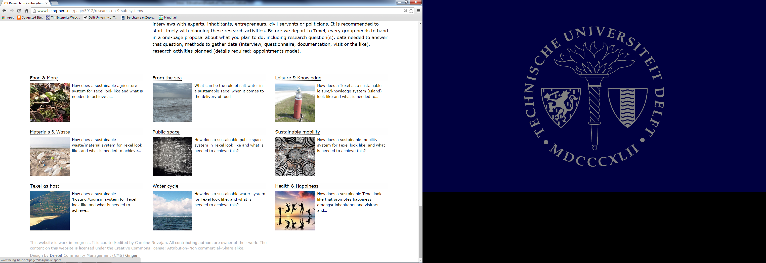

Slide 12
Research activities
(this week 2.1, deadline 17 November)
System Texel
  Study compulsory literature, prepare for next meeting (all individual)
  Report on meeting (group work, Public space)
  Report on literature search and review (all groups plan their interviews, Host)
  Report on interviews (group work, Happiness)
Sub-system research (all group design and work)
  Report on research activities: start exploring the sub-system
  Problem statement and detailed research question (1st draft chapter)
  Plan research design, and start thinking about additional on site (Texel) research
  Column to reflect (all individual)
All data, findings, reports, columns etc have to be shared on being-here.net

Slide 13
Final assessment criteria
All assignments should be handed in, and actively contributed to by assigned students.
All assignments and posts in being-here.net are submitted in time, reflect serious work and professionalism by individuals and groups.
Group research on sub-system reflect about 120 hrs hours/participant of work. The result shows well informed reasoning.
Personal profiles reflect connectedness to others, contributions to system and sub-system, and fascinating columns.
Grading …

Slide 14
Grading
Assignments | Level | Criteria | %
Research contributions | System Texel | Adequate assignments; Quality of synthesis report; Coherence sub-systems; Inspiration; Use of scientific knowledge and insights. | 30
‘Pre’ group report | Sub-system | Depth, quality and coherence of analysis and design; Ambition and creativity; Use of scientific knowledge and insights. | 70
Columns | Reflective | Reflection; Reasoning; Style. | +/- 1 point

