Slide 1
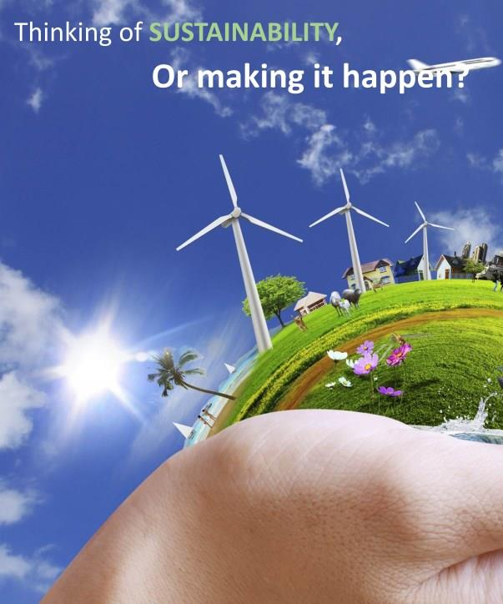
Monday 17 November 2014
8:45-10:30
Exceptionals - Aki, Merel and Chantal - about integrated solutions for sustainability islands
10:35-11:25
Presence as value for design by Caroline Nevejan
11:30-12:30
Sustainable transitions & waste management by Roel van Raak
Meeting 2 – From vision to practice
Engineering for sustainable development WM0939TU

Slide 2
Tuesday 25 November 2014
13:45-14:30
Sustainable initiatives change the world by Gertjan de Werk
14:45-15:45
Biking consultancy tour to Rotterdam
16:45-17:30
Putting sustainable lightning in practice by Iris Dijkstra
Meeting 3 – Transitions made by people
Engineering for sustainable development WM0939TU

Slide 3

Questions? Biking consultancy
Route following the Schie, all the way to a renovated large white building with large windows, opposite the water. Take the bridge and turn right again: Mathenesserdijk 142E.

Slide 4
How do you approach the research on the sub-system?
Doable research question?
What has to be designed?
Keep track of the research progress on Texel and its sub-systems.
Every week 30 columns! Still few are missing …
All contributions visible in your workspace or personal profile?
  Check if you’re the author of your columns and other articles. Some of them are not owned yet.
Organise:
  On site research!
  Interviews on TX topic
  Invoice …!

Slide 5
Final assessment criteria
All assignments should be handed in, and actively contributed to by assigned students.
All assignments and posts in being-here.net are submitted in time, reflect serious work and professionalism by individuals and groups.
Group research on sub-system reflect about 120 hrs hours/participant of work. The result shows well informed reasoning.
Personal profiles reflect connectedness to others, contributions to system and sub-system, and fascinating columns.
Grading …

Slide 6
Tuesday 4 December 2014
8:45-9:45 Oblivion or paradise
9:45-10:30 Institutional context of sustainability transitions by Nienke Saanen
10:30-12:30 ‘Fish’ Game facilitated by Linda van Veen
Meeting 4 – Sustainability transitions in context
Engineering for sustainable development WM0939TU

Slide 7
PM
‘Like’ your favourite columns by adding to ‘Favourites’
  Attractive title, pictures …
  Still few columns are missing!
Next week: mid term review
  Please post the report of your research steps 1-4
  Preferably each group is present
How is interviewing going?
  Reports next week
Prepare your site research at TX
  Tuesday 13 January 2015, 13:30-17:30 hrs
Payments before 8 December!

Slide 8
https://www.youtube.com/watch?v=KphWsnhZ4Ag
The Venus project presents ‘Paradise or Oblivion’

Slide 9
Monday 8 December 2014
8:45-9:30
Energy transitions at Texel
by Cor Leguijt (CE Delft)
9:45-12:30
Mid term review
Meeting 5 – Sustainable energy & sub-system research
Engineering for sustainable development WM0939TU

Slide 10
Mid term review
State of the art:
  Sustainability ambition for the sub system
  How will the future system look like?
  How will future life look like from a individual perspective?
YUTPA revisited:
  Designing for presence: 1st YUTPA future system needs improvement?
  For analysis: discuss and draw YUTPA for current sub-system
  Comparison: what need to change → presentation
Transition needs changes
  Changing needs and ‘presence’
  Bridging differences

Slide 11
TX sustainability ambition: pitch
(Asap) Self sufficient with green energy (direct energy demand)
Food & more
Health & Happiness
Leisure & knowledge
Materials & waste
Public space
Mobility
Host
Water

Slide 12
The sustainable sub-system: poster
Which technologies will be prevailing?
Who are actors, their contribution to the future sub-system?
How will the technologies be embedded in culture and behaviour?
How will technologies, industries, organizations, people etc be interrelated?
Which rules and regulations will organize the future sub-system?

Slide 13
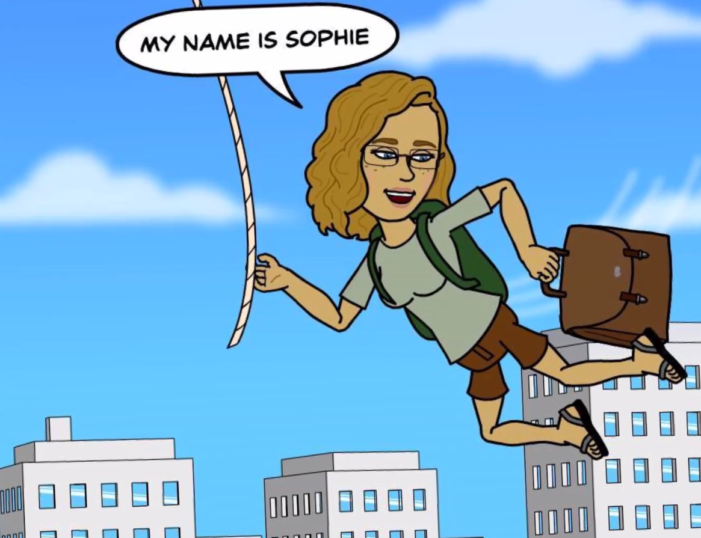

Slide 14
`
http://youtu.be/dE53uHE5Rmw

Slide 15
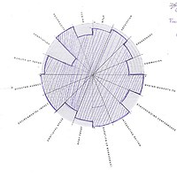
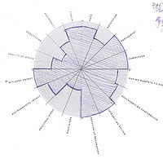
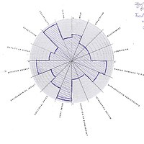
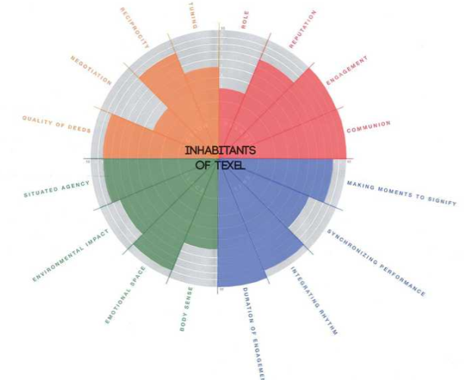
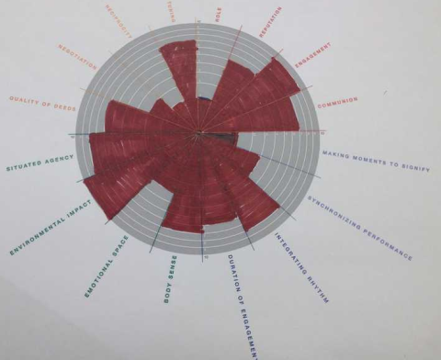
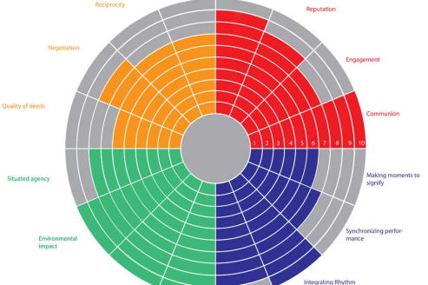
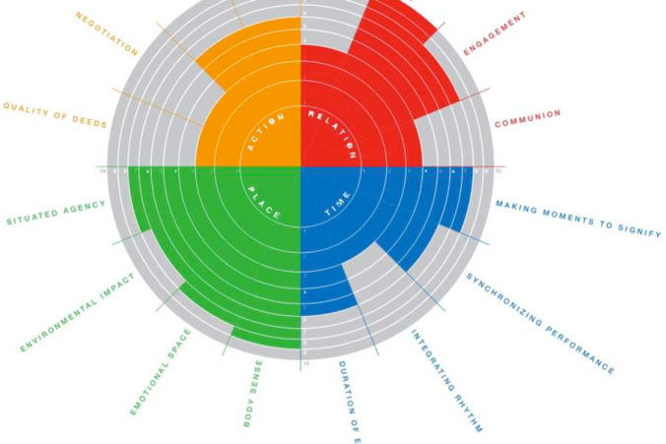
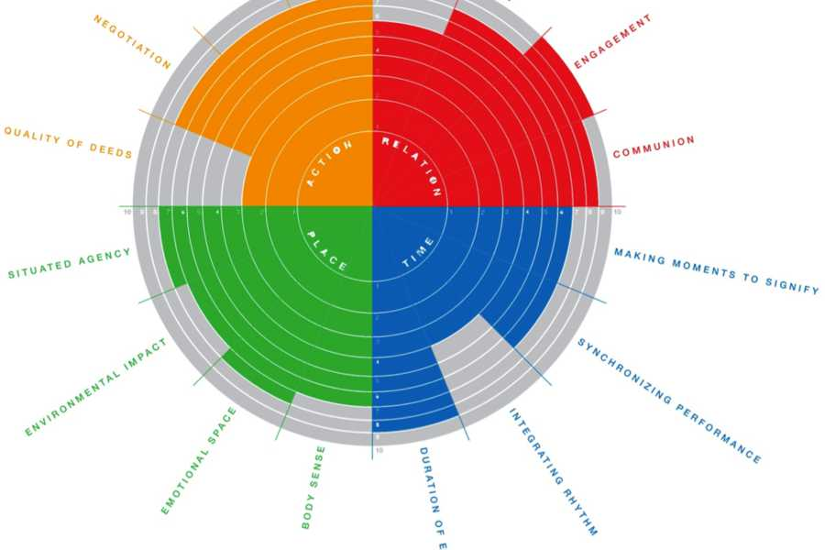
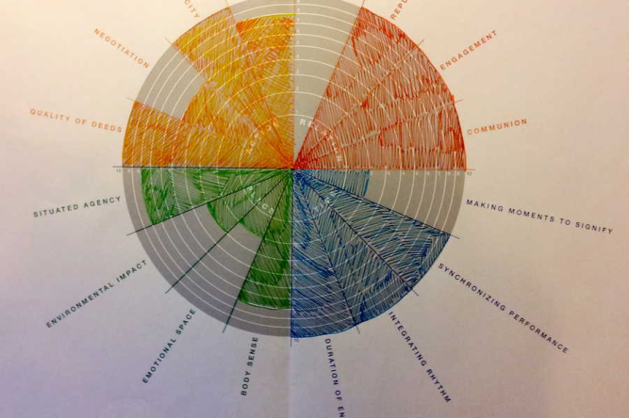
How will the future system look like?
YUTPA for design

Slide 16
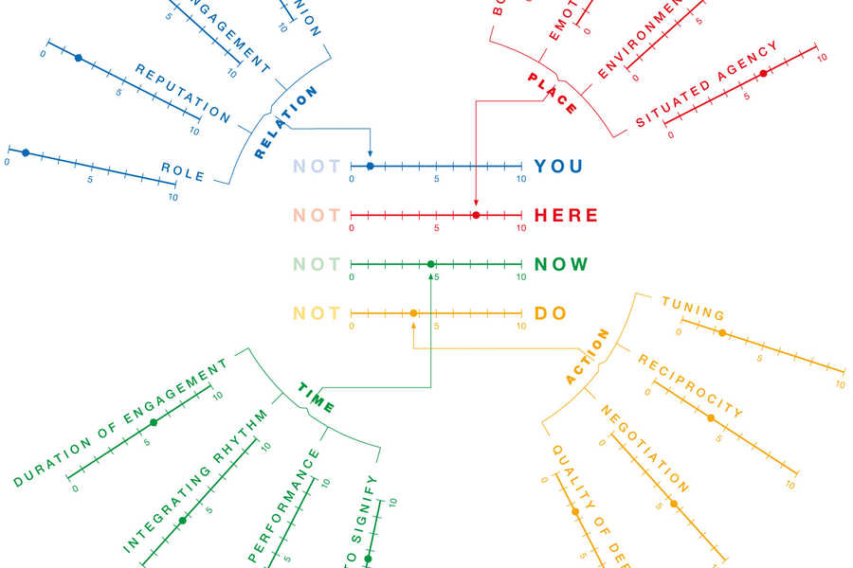
Current situation?
YUTPA for analysis

Slide 17
Comparison Current - sustainability
Energy?
Food & more
Health & Happiness
Leisure & knowledge
Materials & waste
Public space
Mobility
Host
Water

Slide 18
Transforming dynamics of power between now and then
To accept responsibility for sustainability in complex system
What dimensions are in for change?
How to change the sense of presence?
  Think about action/dimension
Design a process for change
  Long term direction and milestones
  Short term action
  Kick start?
  Convincing arguments and line of reasoning!

Slide 19

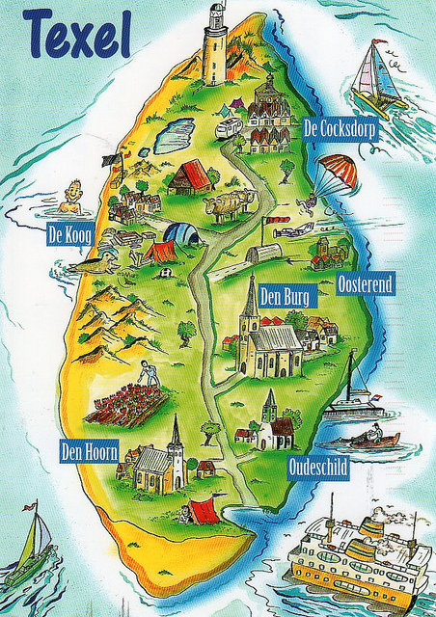
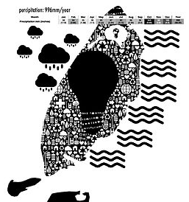
Our sustainable Texel
How to present at the sustainability pub?
Next meeting starts at 13:45 hrs, at YES Delft
After meeting 6: drinks and presentation of TX program
Full draft report before leave to TX
Notes:
I consider Lucas to have some time left to make the movie and/or the maps (each group add a layer?)
The life of Sophie: Movie about sustainable individual life?
Sophie’s world: Mapping the system? Imaginary sustainability map of the island

Slide 20
Tuesday 16 December 2014
8:45-10:30
Sustainable entrepreneurship tour with Yes Delft
10:45-12:15
Leadership Debate with Motiv
12:15-12:30
What’s next: Texel here we come!
Meeting 6 – Leadership
Engineering for sustainable development WM0939TU

