Slide 1
Engineering for Sustainable Development
Sustainable development, socio-technical systems and transitions
Dr. Ir. Eefje Cuppen

Slide 2
Contents
Sustainable development & design of sustainable technology
Socio-technical systems
Transitions

Slide 3
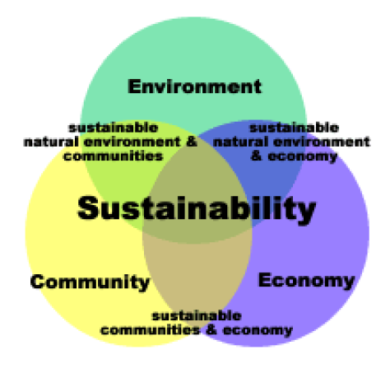
Sustainable development
Sustainable development is:
Development that meets the needs of the present,
without compromising the ability of future generations to meet their own needs.
Triple P:
People, Planet, Profit

Slide 4

An example: biofuel
Arguments in favour:
CO2 reduction
Decrease dependency on oil countries Middle East
Local & decentralized systems→ efficiency & social effects
E.g. CO2 reduction as the main goal: food vs fuel debate

Slide 5
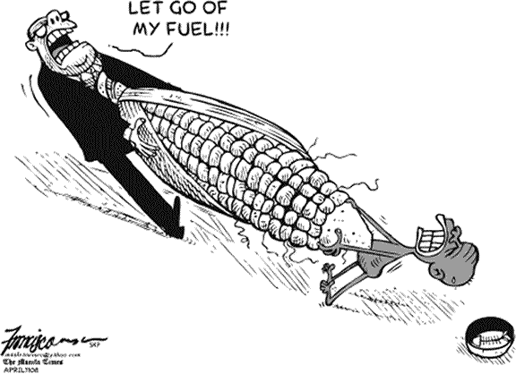
“Converting food into fuel is a monstruous act,” (Fidel Castro, 7 May 2007)
EU directive 2003: 5,75% transportfuel from biomass in 2010, (2009:)10% in 2020, Minister Cramer 2008: 5,75→4%
“The right to live is more important than a full tank.” (Jean Ziegler, rapporteur on right to food, UN)
Notes:
Minister Cramer 2008: 5,75→ 4%
2,6% in 2008

Slide 6
An example: biofuel
So what is more important, reducing CO2 emissions or creating a world that is more fair?
Others say CO2 reductions are less than suggested: better to explore other forms of energy
Cf Mulder et al (2011): different articulations of sustainability
Notes:
Mulder et al: “A sustainable material is, for example, something that needs further specification for material scientists, a material that does not create any health risks is already a more concrete research topic, but making a material that does not contain any organochlorine compounds is a rather concrete articulation for a material scientist to research.”

Slide 7

There is no technological fix
Effects of technology do not depend on inherent characteristics of that technology but on (Mulder et al 2011):
Perception and use of a technology in a social context
How technology affects or even transforms this context
How it interacts with technological systems and its physical context
The time frame of analysis
The quantity of use
So there is no technological fix

Slide 8
How to design for sustainability?
Not all conditions can be fulfilled in one design: dilemma’s and compromises (e.g. biofuel example)
A systems perspective: not only technology, but also culture, actors, rules and regulation
Notes:
“As such, sustainable development has the characteristics of a design project: there are several conditions for a design which cannot all be fulfilled completely. There is not one ‘good’ design but there are several ways of searching for more effective compromises of these demands. And new demands might always be added.”

Slide 9
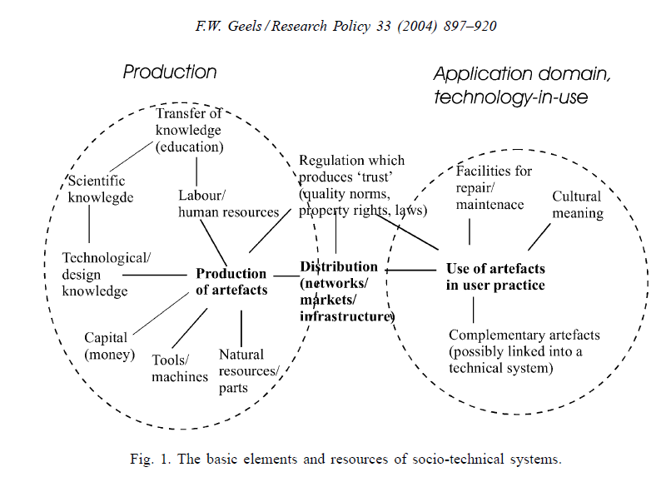
Socio-technical system
Fulfilment of societal functions or needs is central (e.g. mobility, energy, drinking water)
Your assignment:
Technologies
Actors
Culture and behaviour
Rules and regulation
Relations between these

Slide 10
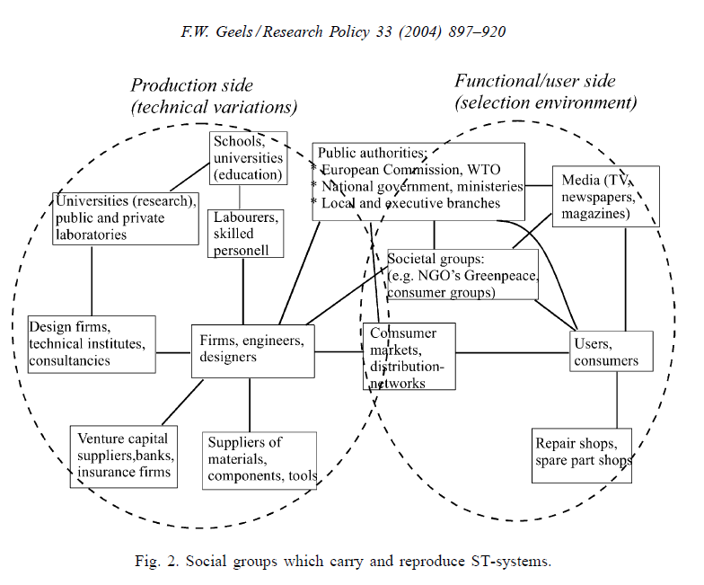
Actors

Slide 11
Culture & behaviour
Culture:
  "learned and shared human patterns or models for living; day- to-day living patterns. these patterns and models pervade all aspects of human social interaction. "
  Damen, L. (1987). Culture Learning: The Fifth Dimension on the Language Classroom. Reading, MA: Addison-Wesley. (p. 367).
  “It is the values, symbols, interpretations, and perspectives that distinguish one people from another in modernized societies; it is not material objects and other tangible aspects of human societies. People within a culture usually interpret the meaning of symbols, artifacts, and behaviors in the same or in similar ways.”
  Banks, J.A., Banks, & McGee, C. A. (1989). Multicultural education. Needham Heights, MA: Allyn & Bacon.

Slide 12
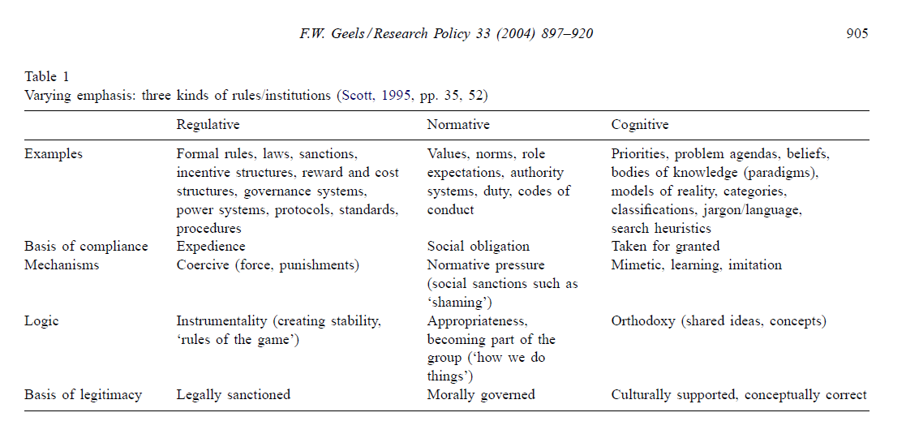
Rules

Slide 13
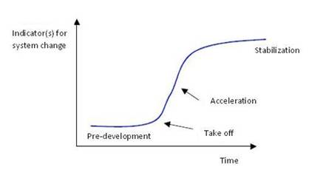
Transition: from one socio-technical system state to another
“ A transition can be defined as a gradual, continuous process of change where the structural character of a society (or a complex sub-system of society) transforms. Transitions are not uniform, and nor is the transition process deterministic: there are large differences in the scale of change and the period over which it occurs. Transitions involve a range of possible development paths, whose direction, scale and speed government policy can influence, but never entirely control.”
Rotmans et al, 2001, Foresight 3(1): 15-31 (p16)

Slide 14
Transitions occur at different levels
Worldwide transitions:
  From hunter-gatherer society to urban society
  From rural to industrial society
  From industrial to sustainable society?
Transitions in socio-technical systems, e.g.:
  From sailing ships to steamships
  From horse-and-carriage to automobiles
  From propeller-piston engine aircraft to turbojets
  (See Geels, 2002, 2005)
Notes:
Great Britain was the world’s leading naval power in the nineteenth century, and led the way in the transition from sail to steam. At first, the introduction of steam technology co-existed with the current regime. Steam tugs assisted sail ships into port and hybrid steam / sail ships appeared. Landscape developments create the necessity for improvements in the technology. A demand for trans-Atlantic emigration was prompted by the Irish potato famine, European political instability and the lure of gold in California. The requirement for such arduous journeys had prompted a wealth of innovations at the niche level in steamship-development. From the late 1880s, as steamship technology improved and costs dropped, the new technology was widely diffused and a new regime established. The changes go beyond a technological transition as it involved new ship management and fleet management practices, new supporting infrastructures and new functionalities.

Slide 15
Transitions in fulfillment of societal functions
  Transition of socio-technical systems
  (also called system innovation)

Slide 16
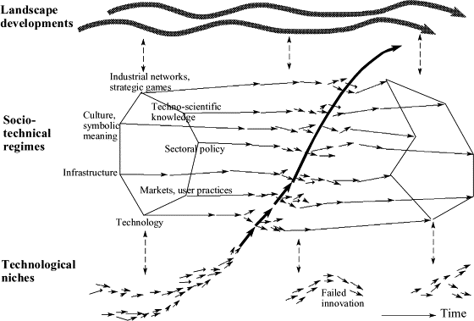
Multi-level perspective
(Geels, 2002)
Your assignment:
Trends, context
Technologies
Actors
Culture and behaviour
Rules and regulation
Relations between these
Initiatives, projects
Public opinion, Climate change, EU regulation, geopolitical relations
Electricity production
system
PV, wind,
biomass

